Slide 1

NYC Restaurant Inspection
Results for Consumers
31 March 2023
APAN5400: Managing Data - Team Proposal
Group 6 ( Team Datacos) - Brendan Ng, Jacob Brandt, Marley An, Sakshi Mehta
Notes:
Marley

Slide 2






🐭🪳🐭🪳🐭🪳🐭🪳🐭🪳🐭🪳🐭🪳🐭🪳🐭🪳🐭🪳🐭🪳🐭🪳🐭🪳🐭🪳🐭🪳🐭🪳🐭🪳🐭
Background
Domino’s (West 125th St)
11/09/2022:
Filth flies or other nuisance pests
03/07/2022
Evidence of mice
Food not protected from potential source of contamination
02/11/2020
Evidence of mice
Evidence of rats
Cold food item held above 41 °F
Atlas Kitchen
10/11/2022:
Evidence of rats
Hand washing facilities not provided or not located where required
Filth flies or other nuisance pests
Cold potentially hazardous food not held at 41 °F or below
Hot potentially hazardous food not held at 140 °F or above
With the increase in health consciousness, cleanliness is a huge factor on deciding where to eat for New Yorkers.
Currently, other than looking with their naked eyes and reading reviews, there is no readily available health inspection information to customers. There are many areas within a restaurant that customers cannot enter, and they are unable to check the health standards of those areas.
NYC Open Data posts inspection results openly on its website primarily for city officials and journalists to review. However, the API is too technical and may be difficult to understand for the the average consumer.
🐭🪳🐭🪳🐭🪳🐭🪳🐭🪳🐭🪳🐭🪳🐭🪳🐭🪳🐭🪳🐭🪳🐭🪳🐭🪳🐭🪳🐭🪳🐭🪳🐭🪳🐭
Notes:
Marley
Before we begin..
Has anyone seen rats, mice, or roaches in New York City? Can we see a show of hands?
Has anyone seen rats, mice, or roaches in restaurants while they were dining? Or other kinds of healthcode violation?
I also have. Once I was having hot pot, the waiter handed me water cup, and there was a live roach in it
Many of us had experience like this, so we had the idea to do our project
Customers are able to see some healthcode violations with their bare eyes
However, most violations happen behind the scene, and customers may not be aware of them
For example, around campus, these are several restaurants that students often go to but may be unaware of their cleanliness
We went through NYC Open data, and found the following violations examples. Therefore, we decided to create this API.

Slide 3
Business Use
Objectives:
Create a web application highlighting NYC restaurant health violations
This API should be easily understandable and convenient for NYC residents to use
It should lay the foundation to be integrated to a larger nation-wide or worldwide API in the future
Potential future collaboration with other APIs, like Google Places, Yelp, OpenTable, holding restaurants accountable to their cleanliness standards
Key API features:
Search functions for restaurant name, zip code, and borough
Interactive map that shows the consumer’s neighborhood
Alerts for violations
Notes:
Marley

Slide 4



Data Source Specification and Procurement Details
We will be using data provided from NYC OpenData (DOHMH New York City Restaurant Inspection Results)
Key variables of this dataset to be used in our project are:
Name of establishment
Cuisine type
Location-based attributes: Borough, longitude, latitude, city council district
Inspection grade and score
Violation codes and their respective descriptions
Updates: Daily (with inspections reported on weekdays)
Size: 90.5 MB*
Data Type: .json
Data Quality:
The overall data quality is high. However, NYC open data aggregate from various sources. There are some missing data (such as restaurant names) and unstructured data, so we cleaned data before storing in database
(*)Data can be connected live and access this data via Socrata OpenData API
URL:https://data.cityofnewyork.us/resource/43nn-pn8j.json
Notes:
Jacob
https://data.cityofnewyork.us/Health/DOHMH-New-York-City-Restaurant-Inspection-Results/43nn-pn8j

Slide 5
Data Source Specification and Procurement Details
Open Data Commons Attribution License (ODC-BY) version 1.0.
Allows users to freely share, use, and distribute the data, as long as they give appropriate credit to the original source of the data.
Requires users to attribute the original source of the data by including a link to the license, and by citing the source of the data in any publications or other works that use the data.
The license also provides a disclaimer of warranties and liability, and limits the liability of the data provider for any damages arising from the use of the data.
Notes:
Jacob
https://data.cityofnewyork.us/Health/DOHMH-New-York-City-Restaurant-Inspection-Results/43nn-pn8j

Slide 6




Proposed Technology Selection and Rationale
Flask API - Flask API will be used by our team as it is a swift, lightweight and popular micro- framework for web applications. Flask will be used to trigger the data ingestion process in the PostgreSQL database. The API will further be used for rendering the data visualizations on the basis of the search filters used by the end-users.
Apache Spark - The ability of Apache Spark in high-speed data querying, analysis, and transformation of large data sets will be crucial for our project. Sparks offers parallel computing that helps in executing code more efficiently, enabling us to save time and money by processing the large-scaled datasets faster. Additionally, Spark helps to make complex data pipelines coherent and easy. Our team will be using the Apache Spark for writing the ETL pipeline for the data ingestion.
PostgreSQL will allow our team to efficiently store all the raw information for the restaurants and their corresponding violations in a well structured manner by creating and joining various tables. Also, PostgreSQL can be seamlessly used to read and write data in our Spark ETL jobs. Additionally, being an open-source database enables PostgreSQL to reduce our overall project budgeting and costs.
Notes:
Sakshi

Slide 7
Proposed Technology Selection and Rationale
Borough
Borough data
Grade
Processed Raw Data*
Health grade of establishment
Restaurants
Information pertaining to the restaurants
Inspection
All inspection related data
(*) Standardized restaurant health code and violations dataset
Notes:
Sakshi

Slide 8
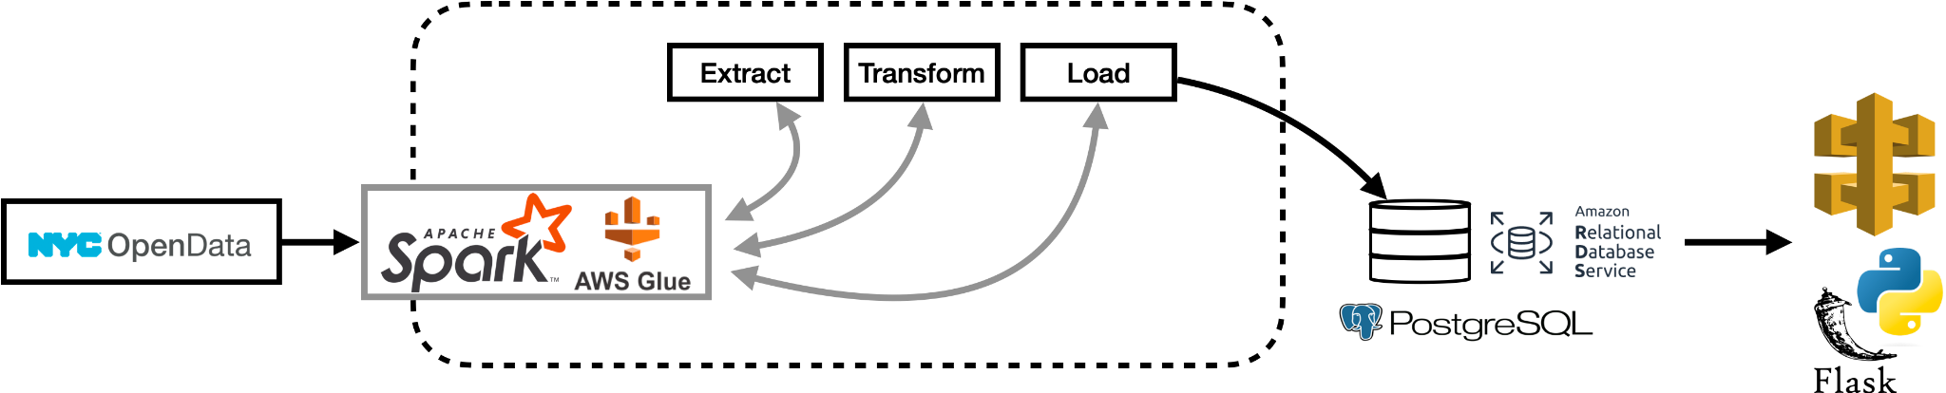
Proposed Technology Selection and Rationale
Notes:
Sakshi

Slide 9



Scalability and Cost Summary
Monthly Cost Estimate
AWS API Gateway $17.90
AWS Glue $1.5
AWS RDS $265.72
------------------------------------
Total $285.12
*Details in appendix. Source:
https://aws.amazon.com/api-gateway/
https://aws.amazon.com/rds/
https://aws.amazon.com/glue/
AWS API Gateway:
Cloud hosting API service (For web app).
AWS Glue:
Data integration cloud service (For breaking down and processing data components, as a server-less service).
AWS RDS:
Cloud setup, operation, and scaling of a relational database for use in our application.
Notes:
Jacob
In the long term, we want to scale this application nationwide and worldwide. We would have many more customers and the cost will also be higher. In addition, we will need to consider marketing cost and hiring people for maintenance.

Slide 10
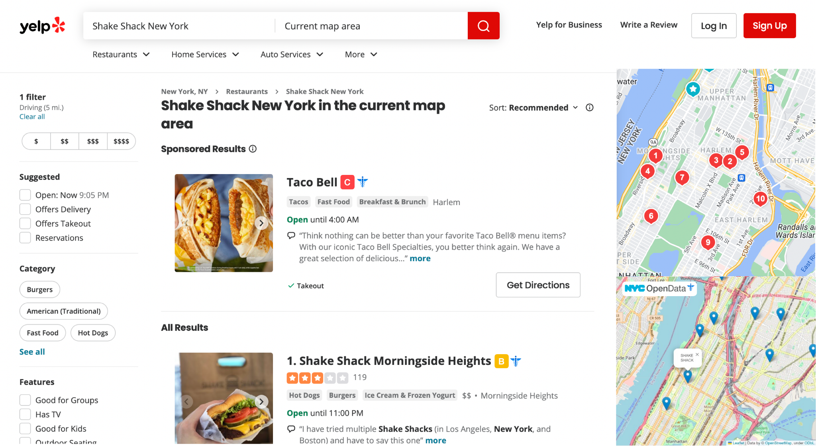
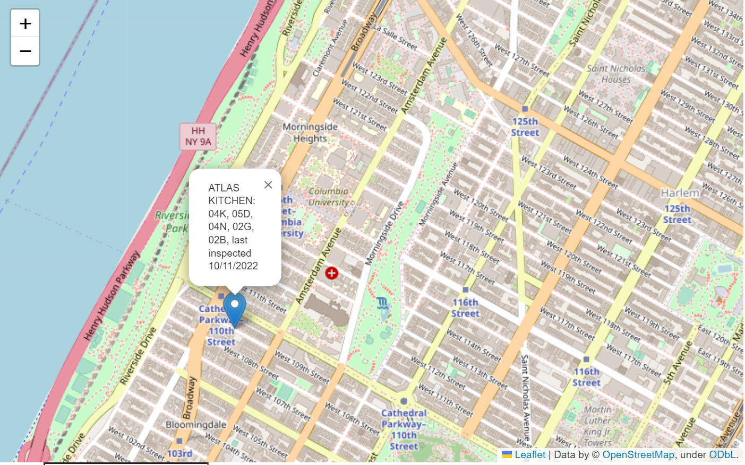
Demonstration
Mock of Integration with Yelp
Notes:
INTRO and CLOSE: Jacob
DEMO: Sakshi and Brendan

Slide 11
Thank you
Questions or suggestions?

Slide 12
Appendix

Slide 13

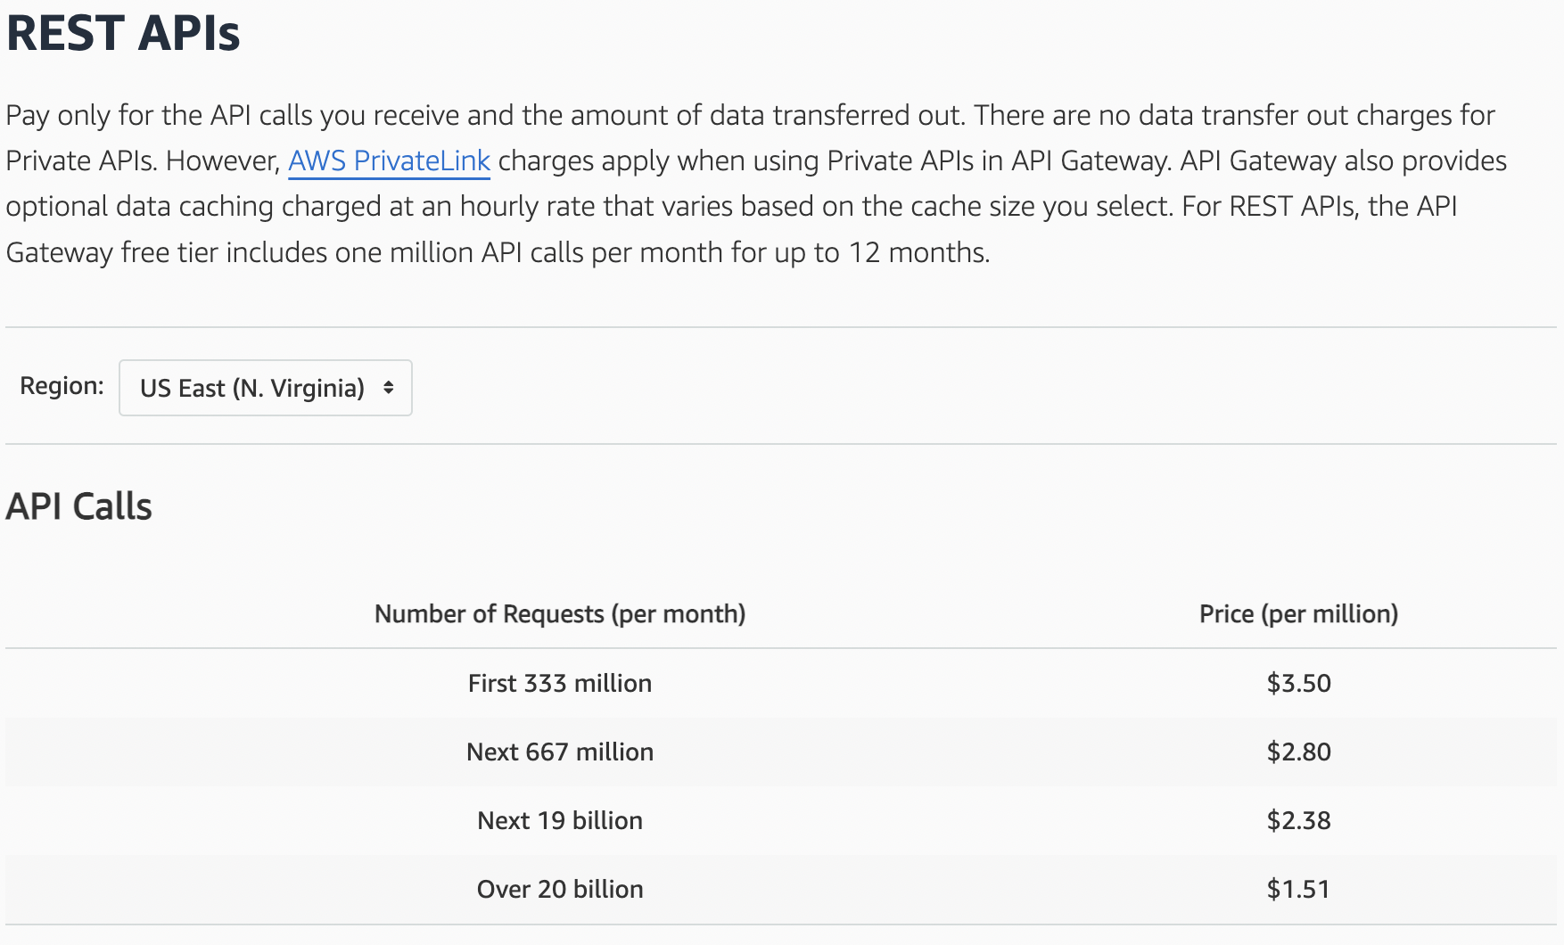
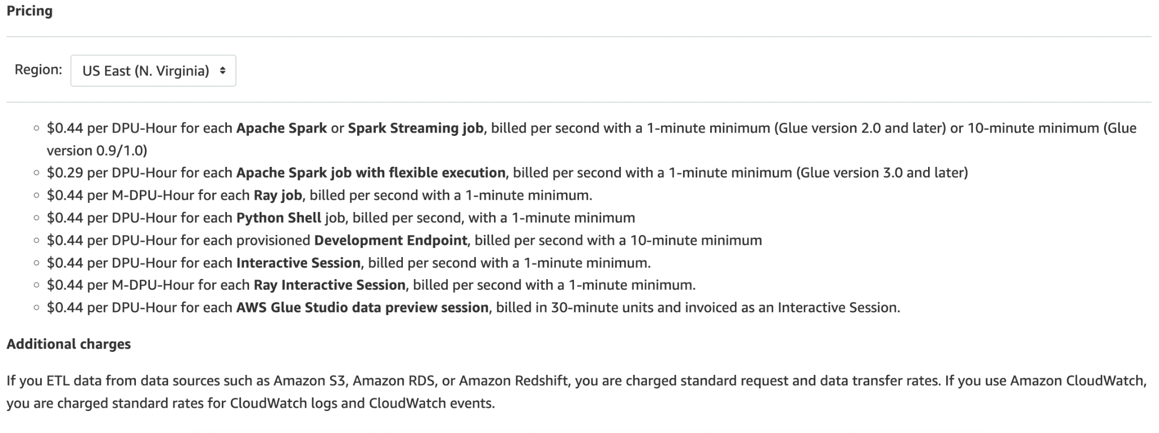
Scalability and Cost
https://aws.amazon.com/api-gateway/
Notes:
https://aws.amazon.com/api-gateway/
https://aws.amazon.com/rds/
https://aws.amazon.com/glue/
No monetary cost associated with Apache Spark and Flask
Cloud based implementation would be far cheaper than proprietary hardware

Slide 14
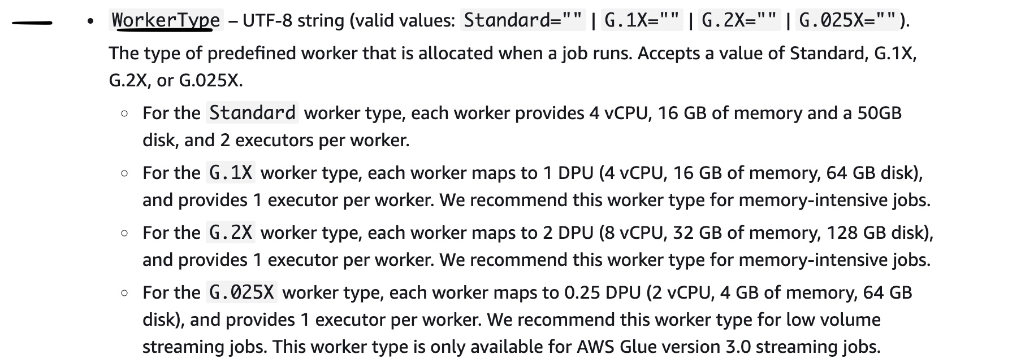
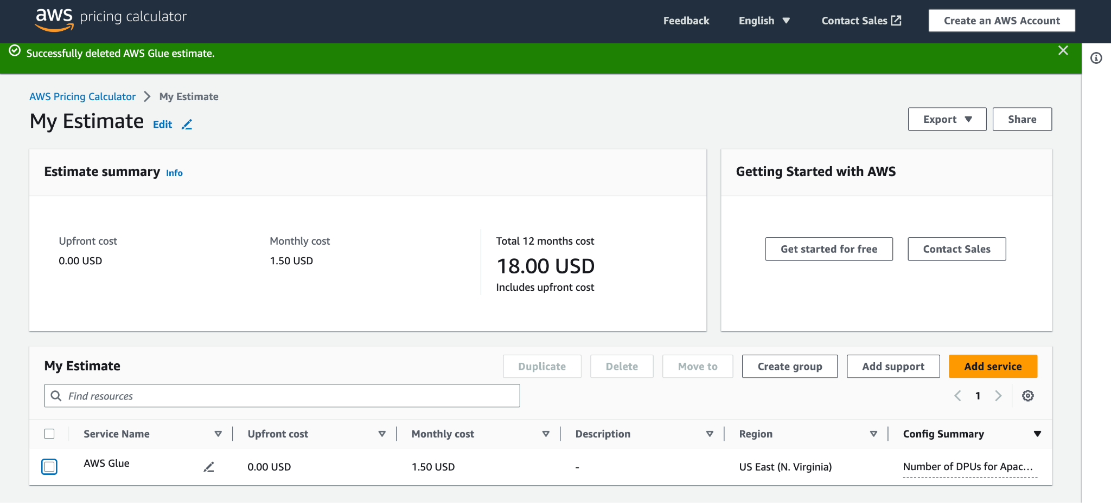
Scalability and Cost
Notes:
https://aws.amazon.com/api-gateway/
https://aws.amazon.com/rds/
https://aws.amazon.com/glue/
No monetary cost associated with Apache Spark and Flask
Cloud based implementation would be far cheaper than proprietary hardware

Slide 15
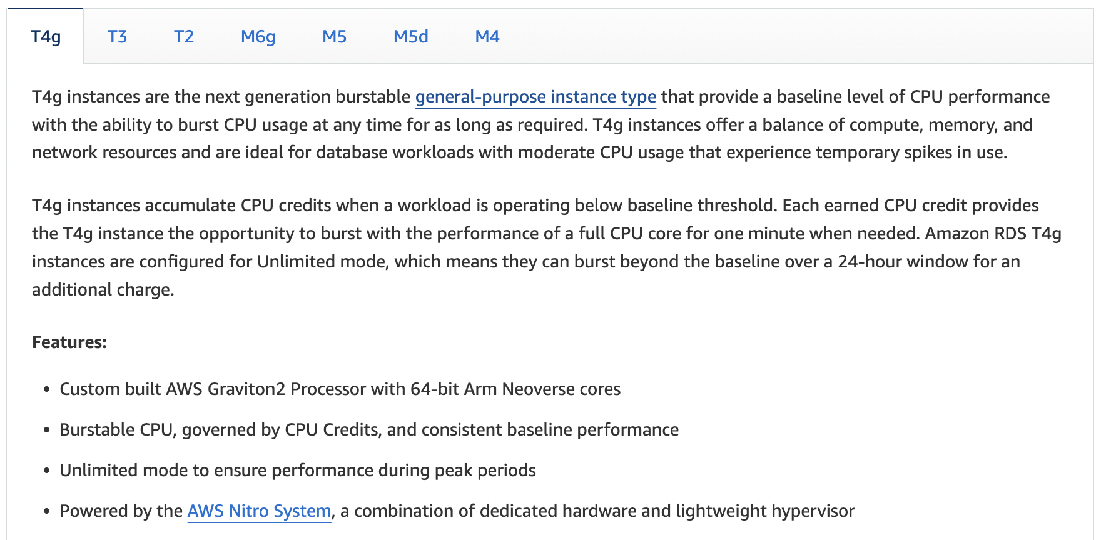
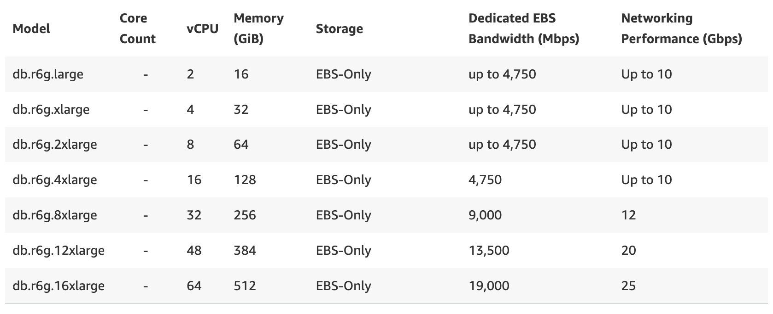
Scalability and Cost
Notes:
https://aws.amazon.com/api-gateway/
https://aws.amazon.com/rds/
https://aws.amazon.com/glue/
No monetary cost associated with Apache Spark and Flask
Cloud based implementation would be far cheaper than proprietary hardware

Slide 16
Data Governance Policy
Data access
All information is public, and accessible to our stakeholders for our business use-case.
Data usage
Intended for the communication, recordkeeping, and education/support of business use-case stakeholders.
Data integration
Avoid and eliminate data silos that are isolated from the rest of the systems.
Data Security
Defining roles for management of the database
Data Strategist: Responsible for administration duties from planning and anticipating the needs of our data users to setting policy changes for data management.
Data Custodians: Responsible for the operation and management of technology and systems that collect, store, process, manage, and provide access to agency data.
Data Stewards: Responsible for monitoring ensure appropriate access, accuracy, classification, privacy and security of the data.
Notes:
Jacob

